Slide 1
Department of Cyber security
III B.Tech II Semester MiniProject-25
Submitted by Batch -1
Advanced Multilingual Translation Platform with Enhanced File and Speech Processing
Presented By -
Supervisor:
Mrs D.Sravanthi
Assistant Professor
Department of Computer Science Engineering (CS&DS)
Names &Roll no:
G.BHANUPRAKASH - 22R21A6217
G.KARTHIKGOUD-22R21A6221
J.SAIRITHVIK - 23R25A6202

Slide 2

Abstract
This project aims to develop an advanced web-based translation platform that extends beyond the capabilities of Google Translate. The system will support file uploads, allowing users to translate large text documents, PDFs, and audio files seamlessly. It will also enable users to download translated text and audio files for convenience. Additionally, the platform will feature real-time speech and text translation, making it a powerful tool for multilingual communication. By integrating AI-powered speech recognition and natural language processing, the system will ensure high translation accuracy and efficiency. Users will have the flexibility to upload audio files, receive translations in both text and speech formats, and download the outputs as needed. This solution is designed to enhance accessibility, streamline cross-language interactions, and cater to individuals, businesses, and global organizations requiring reliable translation services.

Slide 3
Objectives
Develop a Comprehensive Multilingual Translation Platform: Create a user-friendly desktop application that facilitates seamless translation of text and speech across multiple languages in real time.
• Integrate Advanced Language Processing Tools: Utilize powerful Python libraries such as Googletrans for translation, SpeechRecognition for speech-to-text conversion, gTTS for text-to-speech, and python-docx for handling Word documents.
• Enable Multi-Input and Multi-Output Support: Allow users to input text via manual entry, file upload, or microphone/audio file, and provide translated output both as text and spoken audio, with options to save as .docx, .txt, or .mp3.
• Enhance Accessibility and Usability: Design the interface to support various user needs, including language learners, professionals, and general users, with a focus on ease of use, language diversity, and cross-format support.
•Ensure High Translation Accuracy and Performance: Optimize the translation workflow to handle large text files and long audio clips efficiently while maintaining accuracy and minimizing latency during translation and speech processing.

Slide 4
Literature Survey
S.No | Method | Advantages | Disadvantages
1 | upload_text_file() | Supports popular document formats; handles tables in DOCX files; UTF-8 encoding for text files | Limited to .txt and .docx only; no support for PDFs or other formats
2 | upload_audio_file() | Supports multiple audio formats (.wav, .mp3, .ogg, .flac); converts formats for recognition | Requires conversion for some formats; depends on internet for Google API speech recognition
3 | listen_and_translate() | Allows real-time voice input and translation; integrates speech recognition and translation | Limited by microphone quality; speech recognition accuracy affected by noise; requires internet
4 | translate() | Handles large text by chunking; supports many languages; uses Google Translate API | Dependent on Google Translate API availability; may hit API rate limits

Slide 5
Proposed System
The proposed system is a comprehensive multilingual translation platform designed to bridge language barriers through seamless text and speech translation. Built using Python and integrated with powerful libraries such as Googletrans, SpeechRecognition, gTTS, and python-docx, the system enables users to input text through direct typing, audio recordings, microphone input, or document uploads in .txt and .docx formats. It processes the input, translates it into a user-selected target language, and provides the output both as translated text and synthesized speech. The platform also offers functionality to save the translated text as a Word document or plain text file, and the audio output as an .mp3 file, enhancing accessibility across different use cases. With an intuitive and responsive graphical user interface developed using Tkinter, the system ensures a smooth user experience. By supporting over 25 languages and accommodating multiple input/output formats, this translation platform aims to serve as a versatile tool for users in educational, professional, and personal communication contexts.

Slide 6
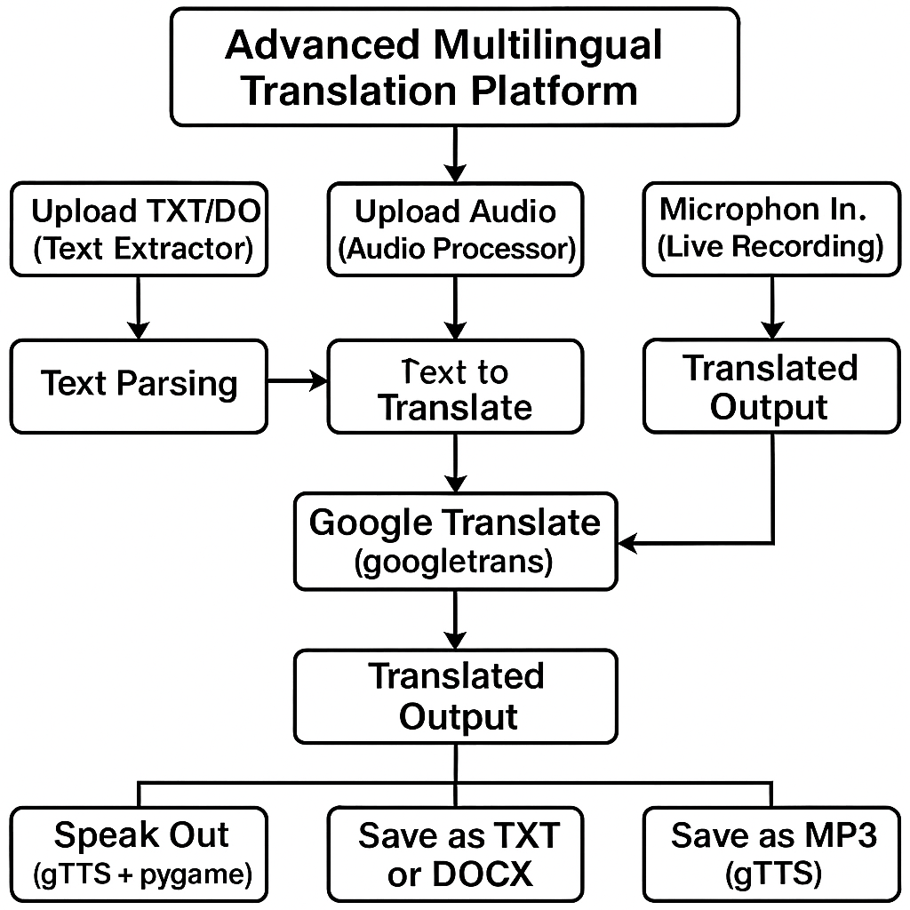
Architecture

Slide 7
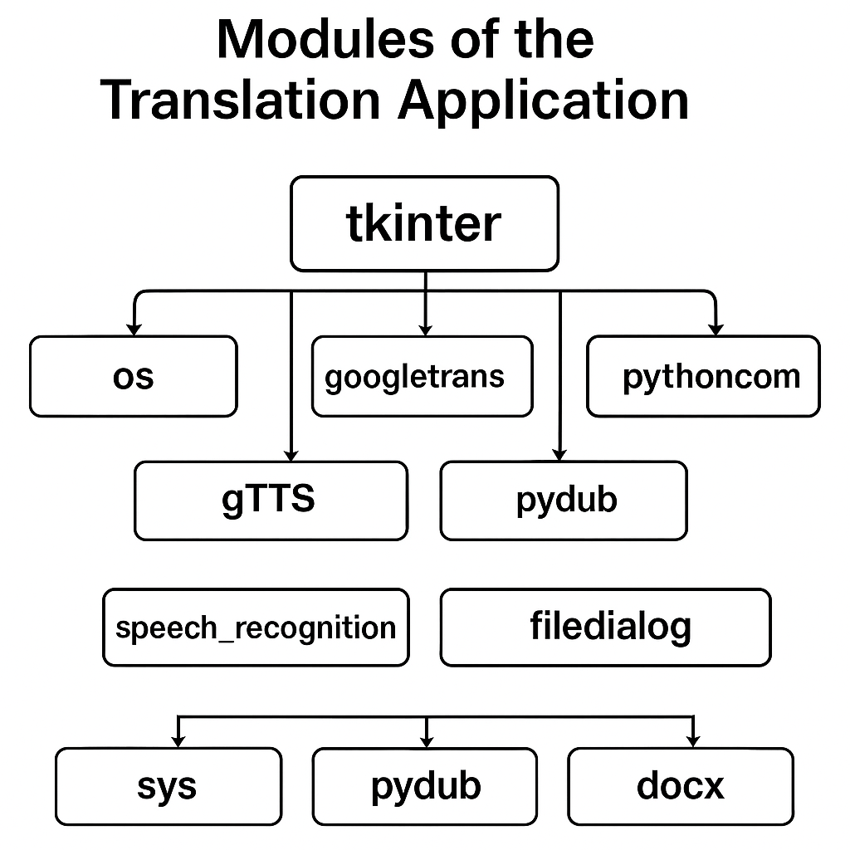
UML Diagrams(Module wise)

Slide 8
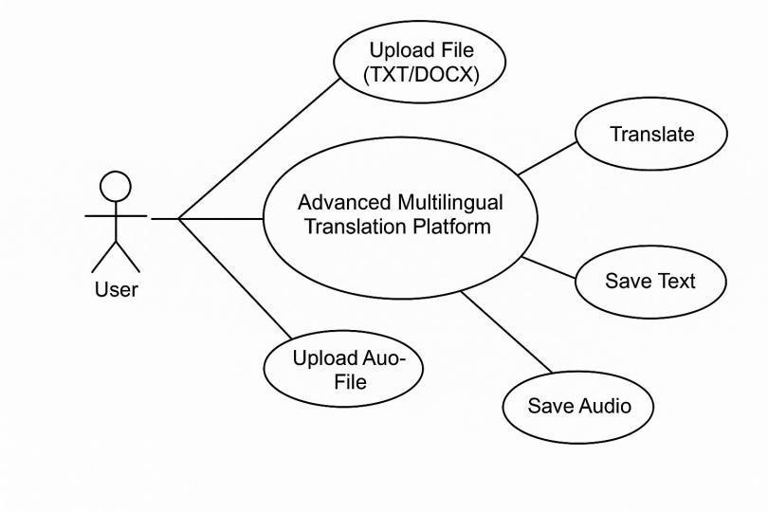
Use case Diagram

Slide 9
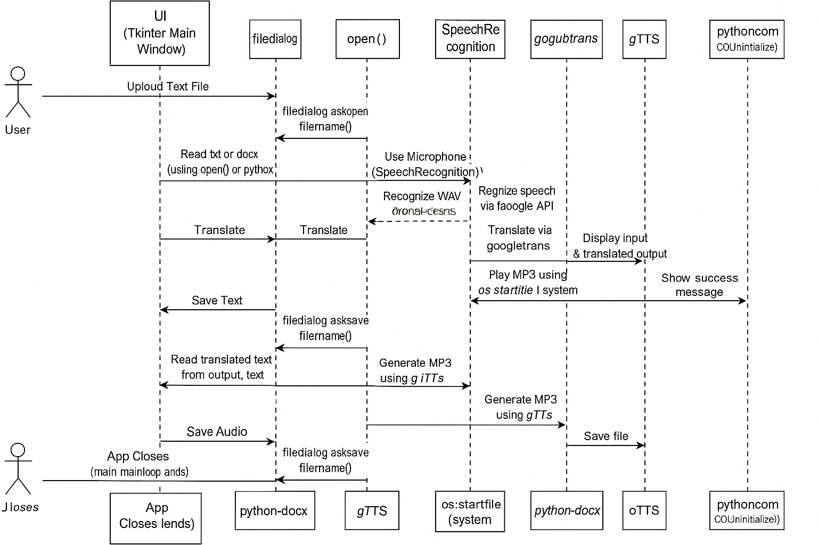
Sequence Diagram

Slide 10
Methodologies
Multilingual Text Translation : Allows translation between English and 25+ languages.Supports both manual text input and document/audio input.
Speech-to-Text and Text-to-Speech: Converts spoken language to text (using microphone or uploaded audio).Converts translated text into spoken output (TTS).
Speech Recognition :Uses Google Speech Recognition to convert audio to text.Automatically adjusts for ambient noise.Handles long inputs using timeout and phrase limits.
Text-to-Speech (TTS) : Uses Google TTS (gTTS) to convert text to speech in target language.Saves audio as .mp3 or .wav.
Error Handling: Robust exception handling with clear user alerts.
Multi-platform Compatibility: Audio playback commands vary based on OS.

Slide 11
Algorithms
Speech Recognition Algorithm
Library: speech_recognition (Google Web Speech API)
Algorithm Involved:
Hidden Markov Models (HMMs)
Deep Neural Networks (DNNs)
Acoustic Model + Language Model combination
Purpose: Converts spoken audio into text using Google's pretrained voice models.
Translation Algorithm :
Library: googletrans (Unofficial Google Translate API)
Algorithm Involved:
Neural Machine Translation (NMT)
Sequence-to-Sequence Models with Attention Mechanisms
Transformer (like in Google's original NMT systems)
Purpose: Translates input text to the target language using deep learning-based translation models.

Slide 12
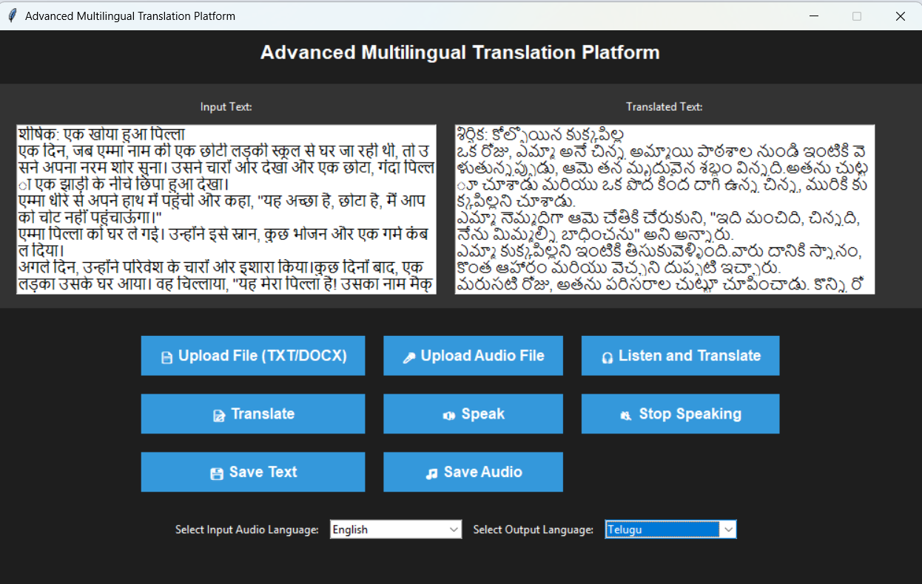
Results

Slide 13
Future Enhancements
Offline Translation and Speech Recognition:Integrate offline translation models (e.g., OpenNMT, MarianMT) and speech recognition (e.g., Vosk, Whisper) to reduce dependence on internet connectivity and enhance privacy.
Expanded Language Support:Add more regional and less commonly supported languages, along with dialect options, to increase inclusivity.
Error Handling and Feedback:Implement better error correction and suggestions for misunderstood speech or translation ambiguities, possibly using NLP models.
Integration with Cloud Services:Support saving translations to cloud storage (e.g., Google Drive, Dropbox) and sharing outputs directly via email or social media.
Multi-modal Input and Output:Extend support for image-based text recognition (OCR) to translate text in images, and enable output as subtitles or visual cards for presentations.
Mobile and Web Versions:Develop cross-platform versions for mobile (Android/iOS) and web, enabling broader accessibility and convenience.

Slide 14
Conclusion
The development of a multilingual translation platform with advanced translation features using Python, Tkinter, speech recognition, and the Google Translate API demonstrates a significant step toward breaking language barriers. This project integrates speech-to-text conversion, real-time translation, and text-to-speech functionalities to provide a seamless communication experience. By leveraging modern technologies, the platform ensures accuracy, efficiency, and user-friendliness.Through the literature survey, we identified existing challenges in translation tools, such as accuracy limitations and lack of contextual understanding. Our platform aims to address these by incorporating advanced speech recognition and interactive GUI elements. The implementation showcases the potential for enhancing cross-lingual communication, especially in global businesses, education, and accessibility for individuals with language constraints.Future improvements could include AI-based contextual translation, support for more languages, and integration with mobile platforms.

Slide 15
Thankyou

